Slide 1

Demographics:
woman
19 y.o.
Occupation:
student
Story:
She is a university out-of-town student on a tight budget, lives mainly on her scholarship, tries to get grants, tries to be involved in extracurricular activities for the increased scholarship. Seeks comfortable but fashionable solutions for her wardrobe.
Goals:
Discover budget-friendly but still trendy outfits
Find versatile clothes
Be informed about sales or discounts from local stores and second-hands
Aisulu
Budget-conscious

Slide 2

 | Demographics: woman 25 y.o. Occupation: digital marketing professional Story: She is a digital marketing specialist, so her days blend creativity and technology. With an eye for detail, she easily transforms everyday moments into fashion statements.In her busy urban life,Aigerim encounters the challenge of managing her wardrobe efficiently.Juggling work meetings, social events and spontaneous outings, she wants an app that seamlessly organizes her extensive collection and suggests trendy combinations. | Goals: Wants to use her own style to start conversations and meet people who share her interests, including professionals and mentors. make shopping less time consuming by using websites and nearby stores that match her budget and style. Be able to manage her wardrobe more efficient
Aigerim
Fashion Enthusiast

Slide 3

Demographics:
woman
32 y.o.
Occupation:
business analyst
Story: she juggles recent motherhood with her busy work life, always needing to look professional for meetings. She's great at making decisions and now wants to streamline her daily routines to focus more on family time and leadership at work.
Goals:
Organize her wardrobe efficiently to save time on daily outfit decisions.
Pre-plan outfits for the week to ensure a professional look for all meetings.
Delegate style choices to the app, focusing more on work and less on appearance.
Elena
Busy Professional

Slide 4
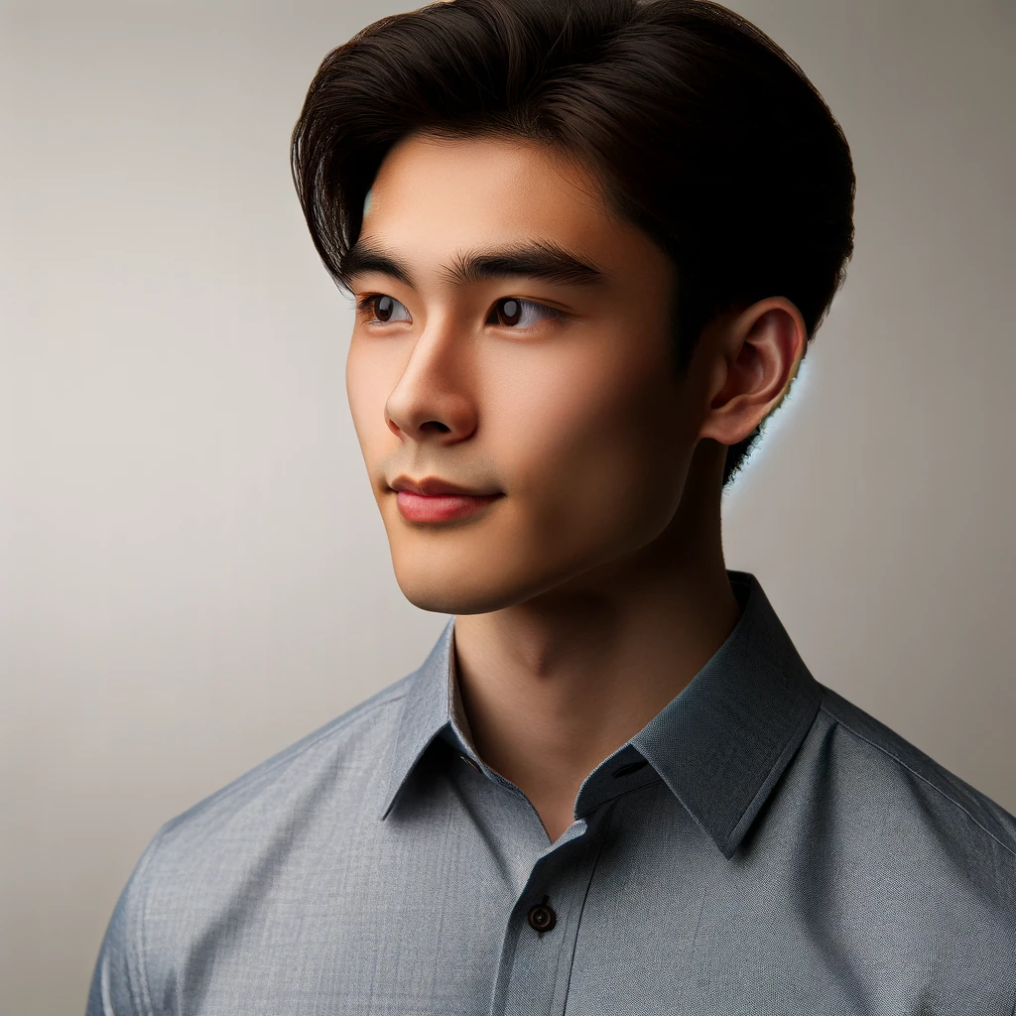
Demographics:
man
22 y.o.
Occupation:
backend developer
Story: A recent college graduate starting his career, living independently for the first time, learning to manage his clothing budget. Not passionate about fashion but values looking good. Seeks an efficient way to enhance his style.
Goals:
Gain simple, effective styling advice to match his personal and professional look without extensive fashion knowledge.
Build a versatile, minimalist wardrobe for effortless outfit matching.
Stay within budget on quality, timeless pieces for any occasion.
Alan
Young Professional

Slide 5
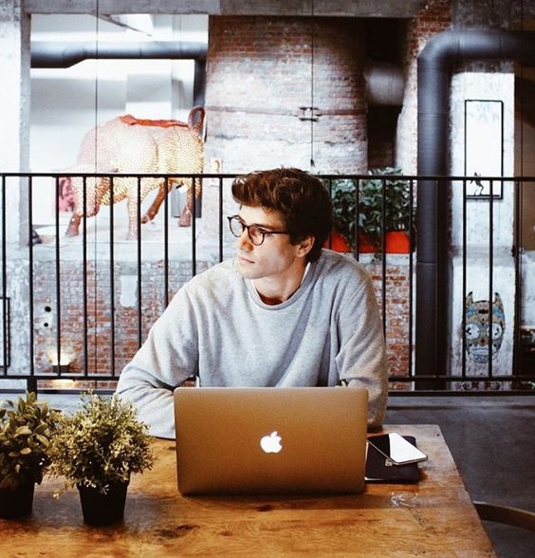
Demographics:
man
30 y.o.
Occupation:
IT worker in the office
Story: He is a laid-back 30-year-old man navigating the routine of office life without much fuss about fashion. Jake's world revolves around deadlines, meetings, and the comfort of his go-to work attire – a rotation of button-down shirts or sweaters and casual jeans. Fashion trends may come and go, but Jake is content with simplicity.
Goals:
Obtain simple, effective styling advice for a professional look without extensive fashion knowledge.
Create effortless outfits for any occasion by building a versatile, minimalist wardrobe.
Stay within budget while investing in quality, timeless pieces.
Alexey
Ordinary Man

